Slide 1
C++ Data Types and Strings
8/28/17
Zybooks Chapter 2

Slide 2
Outline
Variable Basics
Assignment
Identifiers
Data Types
Numbers
Alpha-Numeric
Math Functions
Type Conversions
Binary and Hexadecimal
Random Numbers
Boolean Variables

Slide 3
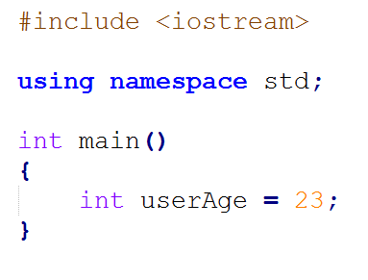
Variable Basics
Variable – represents a memory location used to store data
 | Memory
0x00001c
0x000020 | 23 | userAge
0x000024
0x000028

Slide 4
Variable Basics
Variable – represents a memory location used to store data
 | Memory
0x00001c
0x000020 | 23 | userAge
0x000024
0x000028
Expression
Declaration
Initialization

Slide 5
Assignment
variableName = expression;
Expression can be:
A number:
appleNum = 25;
Another variable:
orangeNum = appleNum;
Summation of Variables
fruitTotal = orangeNum + appleNum;
Itself
fruitTotal = fruitTotal + 12;
Combination
produceTotal = fruitTotal + 25;

Slide 6
Identifier
Another word for variable name:
Simple Rules:
Must be a combination of letters and numbers
Underscore “_” is considered a letter
Must start with a letter
Cannot contain reserved word
Cannot contain certain symbols
! @ # $ % ^ & * ( ) - + = { } [ ] | \ : ; ” ’ < , > . ? /
Case Sensitive
appleNum ≠ APPLENUM
No white space

Slide 7
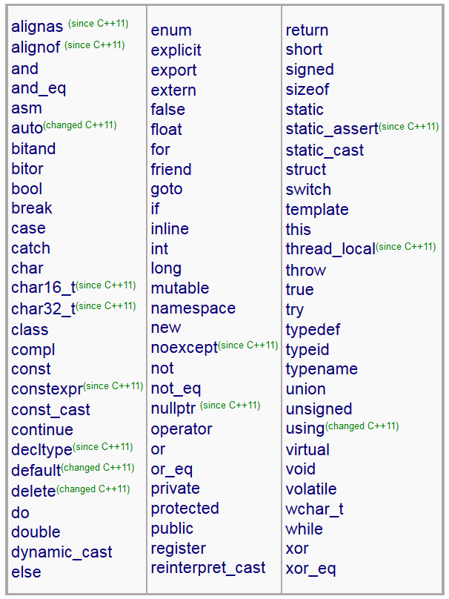
Identifier – Reserved Words

Slide 8
Identifier - Is it Valid?
numStudents
num_Students1
_numStudents
___numStudents
num Students
1stInClass
firstInClass_
firstInClass!
tall
short
very tall

Slide 9
Identifier - Is it Valid?
numStudents
num_Students1
_numStudents
___numStudents
num Students
1stInClass
firstInClass_
firstInClass!
tall
short
very tall

Slide 10
Identifier - Is it Valid?
numStudents
num_Students1
_numStudents
___numStudents
num Students
1stInClass
firstInClass_
firstInClass!
tall
short
very tall

Slide 11
Identifier - Is it Valid?
numStudents
num_Students1
_numStudents
___numStudents
num Students
1stInClass
firstInClass_
firstInClass!
tall
short
very tall

Slide 12
Identifier - Is it Valid?
numStudents
num_Students1
_numStudents
___numStudents
num Students
1stInClass
firstInClass_
firstInClass!
tall
short
very tall

Slide 13
Identifier - Is it Valid?
numStudents
num_Students1
_numStudents
___numStudents
num Students
1stInClass
firstInClass_
firstInClass!
tall
short
very tall
No White Space is allowed in variable name.

Slide 14
Identifier - Is it Valid?
numStudents
num_Students1
_numStudents
___numStudents
num Students
1stInClass
firstInClass_
firstInClass!
tall
short
very tall
Has to start with a letter, not a number.

Slide 15
Identifier - Is it Valid?
numStudents
num_Students1
_numStudents
___numStudents
num Students
1stInClass
firstInClass_
firstInClass!
tall
short
very tall

Slide 16
Identifier - Is it Valid?
numStudents
num_Students1
_numStudents
___numStudents
num Students
1stInClass
firstInClass_
firstInClass!
tall
short
very tall
Cannot have a reserved symbol.

Slide 17
Identifier - Is it Valid?
numStudents
num_Students1
_numStudents
___numStudents
num Students
1stInClass
firstInClass_
firstInClass!
tall
short
very tall

Slide 18
Identifier - Is it Valid?
numStudents
num_Students1
_numStudents
___numStudents
num Students
1stInClass
firstInClass_
firstInClass!
tall
short
very tall
Cannot be a reserved words.

Slide 19
Identifier - Is it Valid?
numStudents
num_Students1
_numStudents
___numStudents
num Students
1stInClass
firstInClass_
firstInClass!
tall
short
very tall
No White Space is allowed in variable name.

Slide 20
Identifier
Identifier Naming Conventions:
Dependent on where you go and who you are writing the code for
Common Rules:
Regular variables start with lower case letter. Capitalize the remaining letters in variables
Ex: thisIsAnExampleOfALongVariable
Words are separated by underscore
Ex: this_is_an_example_of_a_long_variable
Meaningful – self describe the item’s purpose
Related to what the variable means
Short, sweet, and to the point
Easy to read/understand

Slide 21
Identifier – Meaningful Matchup
Concept to variable Name:
Number of Quarters

Slide 22
Identifier – Meaningful Matchup
Concept to variable Name:
Number of Quarters – numQtr, num_Quarter
Total distance traveled

Slide 23
Identifier – Meaningful Matchup
Concept to variable Name:
Number of Quarters – numQtr, num_Quarter
Total distance traveled – distanceTotal, total_distance
Student Grade Point Average

Slide 24
Identifier – Meaningful Matchup
Concept to variable Name:
Number of Quarters – numQtr, num_Quarter
Total distance traveled – distanceTotal, total_distance
Student Grade Point Average – studentGPA
Year

Slide 25
Identifier – Meaningful Matchup
Concept to variable Name:
Number of Quarters – numQtr, num_Quarter
Total distance traveled – distanceTotal, total_distance
Student Grade Point Average – studentGPA
Year - year

Slide 26
Data Types - Numbers
Integers – whole numbers
1, 2, 3, … etc., -1, -2, -3 … etc.
Can be preceded with short, long, and long long
int number = 3;
Floating point – fractions
-1.05 , 0.001, …
float number = 23.5;
double number = 15.667;
Cannot be preceded with short, long, or long long

Slide 27
Data Types - Numbers
Definition | Size | Number Range
int myVar; | 32 bits | -2,147,483,648 to 2,147,483,647
short myVar; | 16 bits | -32,768 to 32,767
long myVar; | 32 bits | -2,147,483,648 to 2,147,483,647
long long myVar; | 64 bits | -9,223,372,036,854,775,808 to 9,223,372,036,854,775,807
float myVar; | 32 bits | -3.4×10³⁸ to 3.4×10³⁸
double myVar; | 64 bits | -1.7×10³⁰⁸ to 1.7×10³⁰⁸

Slide 28
Data Types - Numbers
Definition | Size | Number Range
unsigned int myVar; | 32 bits | 0 to 4,294,967,295
unsigned short myVar; | 16 bits | 0 to 65,535
unsigned long myVar; | 32 bits | 0 to 4,294,967,295
unsigned long long myVar; | 64 bits | 0 to 184,467,440,737,095,551,615

Slide 29
Data Types – Alpha-numeric
Character – single character (letter or symbol)
‘m’, ‘1’, ‘%’, ‘♦’
char letter = ‘m’;
Characters have integer value equivalents
‘%’ – 37
‘A’ – 65
‘a’ – 97
[More at : http://www.asciitable.com/]
[More at : Zybooks 2.10]

Slide 30
Data Types – Alpha-numeric
Character String (C String) – characters in an array
char str[6] = “hello”;
Address | Memory
77 | ‘H’ | str
78 | ‘e’
79 | ‘l’
80 | ‘l’
81 | ‘o’
82 | ‘\0’

Slide 31
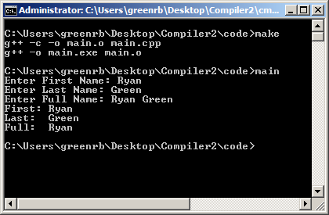
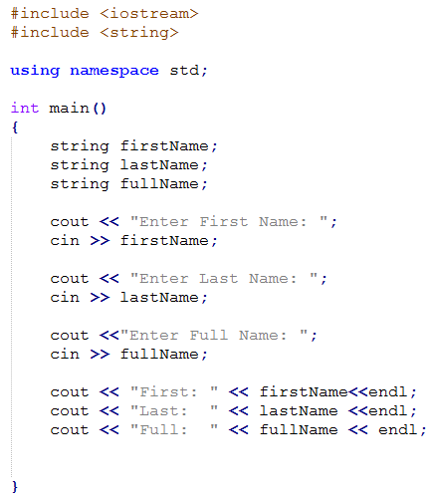
Data Types – Alpha-numeric
String – alternative to C Strings
Must - #include <string>
string message = “Hello”;
cin – gets the next input only to the next space;
getlin(cin, strVar) – gets input until <ENTER> key is clicked

Slide 32
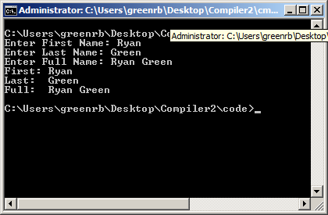
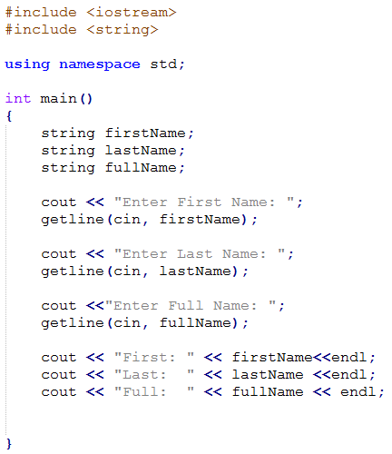
Data Types – Alpha-numeric
String – alternative to C Strings
Must - #include <string>
string message = “Hello”;
cin – gets the next input only to the next space;
getline(cin, strVar) – gets input until <ENTER> key is clicked

Slide 33
Data Types – Alpha-numeric
String – Common functions
Length of string
str.length(); str.size();
Adding to the end of string
str2 = str + “End of String”;
Appending String
str +=“End of String”; str.append(“End of String”);

Slide 34
Data Types – Alpha-numeric
String – Common functions
Character at index []
char letter = str[i];
Substring
str.substr(3,5) – substring from index 3 to 5
str.substr(5) – substring from index 5 to the end
Finding in string
str.find(“hello”) – returns the position of “hello” in str. Returns string size if not found

Slide 35
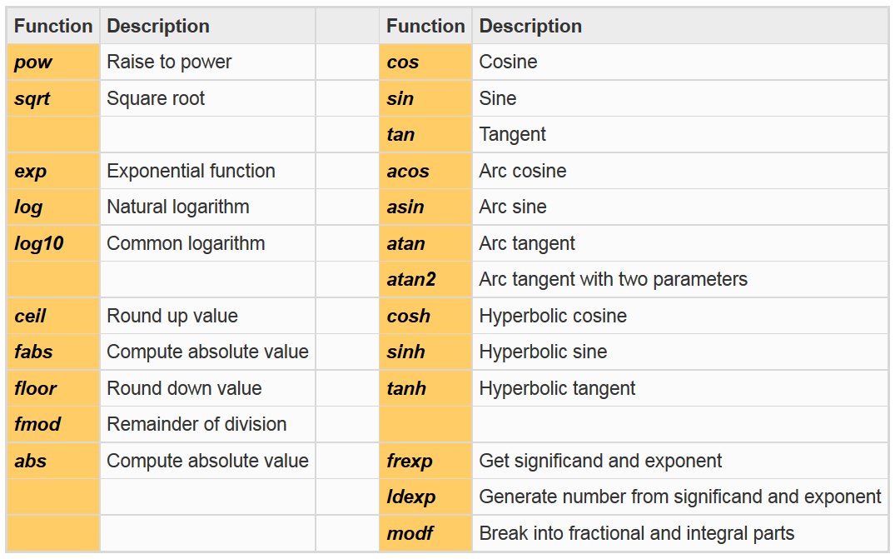
Math Functions
#include <cmath> - for those who need more math than + - * / and %
More at http://www.cplusplus.com/reference/cmath/

Slide 36
Math Functions
pow(x,y) – raises x to the y power
x^{y}
sqrt(x) – returns the square root of x
ceil(x) – rounds up x to the nearest integer value
ceil(2.36) returns 3.0
floor(x) – rounds down x to the nearest integer value
floor(2.36) – returns 2.0
abs(x) – returns the absolute value of x
sin(x) – returns the sine of angle x (in radians)

Slide 37
Type Conversions
Conversion from one data set to another
Implicit Conversion – Done automatically by the compiler.
int to double : 25 becomes 25.0
double to int : 4.9 becomes 4.0
Happens with mathematical operators.
3.0/1.5 = 2.0 double 15/2 = 7 integer
3.0/2 = 1.5 double 15/2.0 = 7.5 double
double val_float; int val_int;
val_float = 3*0.5 = 1.5 double
val_int = 3*0.5 = 1 integer

Slide 38
Type Conversions
Conversion from one data set to another
Explicit Conversion – conversion from one data type to another specified by the programmer
static_cast<type> (expression)
Example: Working Example
static_cast<double> (3+4) / static_cast<double>(2)
Yields: 3.5
Example: Common Error
static_cast<double> ((3+4)/2)
Yields: 3.0 (because (3+4)/2 yields 7)

Slide 39
Binary and Hexadecimal
DECIMAL
526 = 5×10² +
2×10¹ +
6×10⁰
BINARY
1101= 1×2³ + = 13 (dec)
1×2² +
0×2¹ +
1×2⁰
Hexadecimal
0 – 0 8 – 8
1 – 1 9 – 9
2 – 2 10 – A
3 – 3 11 – B
4 – 4 12 – C
5 – 5 13 – D
6 – 6 14 – E
7 – 7 15 – F

Slide 40
Binary and Hexadecimal
Hexidecimal
1A3F = 1 ×16³ + = 6719 (dec)
(A) 10×16² +
3 ×16¹ +
(F) 15×16⁰

Slide 41
Random Numbers
Must #include <cstdlib>
rand() – returns an integer in the range of
0 to RAND_MAX (computer dependent)
RAND_MAX typically 32767
srand(x) – seeds pseudo random number generator
Has to be used before any instance of rand() can be called
Has to have a number seeded

Slide 42
Random Numbers
srand(time(0)) – random numbers each time you run the program
Must #include <ctime> in order to use time(0)

Slide 43
Boolean
Boolean – True or False values
Example:
bool outcome = true;
Or
bool flag = false;

Slide 44
Boolean
Can be used with Boolean operators from C:
! – NOT (or OPPOSITE)
&& - AND
|| - OR
Can be used within if-statements, loops, …

Slide 45
Examples: If Time
Hello World – Getting the Environment setup.
Angles – CMATH example
IF –Else Statements – BOOLEAN Example

